Slide 1

James Gosling
Made by: Ákos Hegedüs

Slide 2
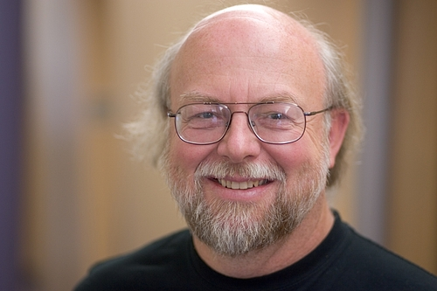
Who is James Gosling
He was born in: James Arthur Gosling May 19, 1955, Canada

Slide 3
Java

Slide 4
Awards

